Slide 1
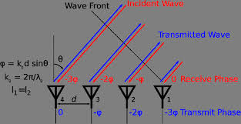
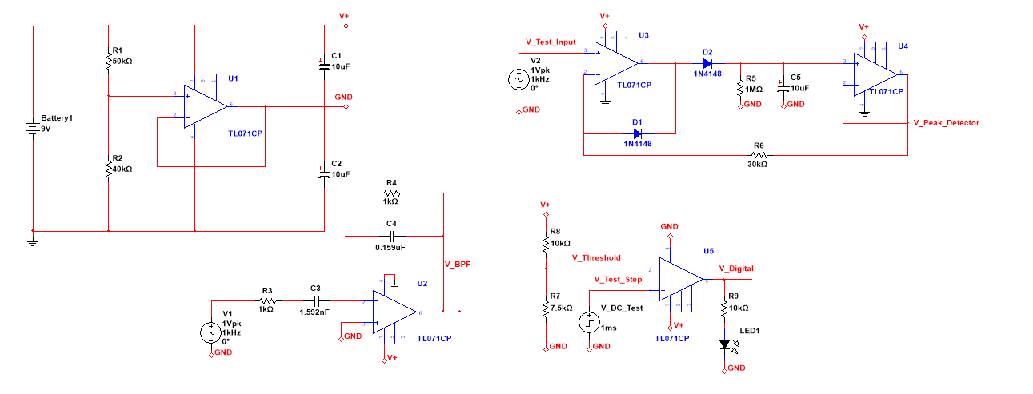
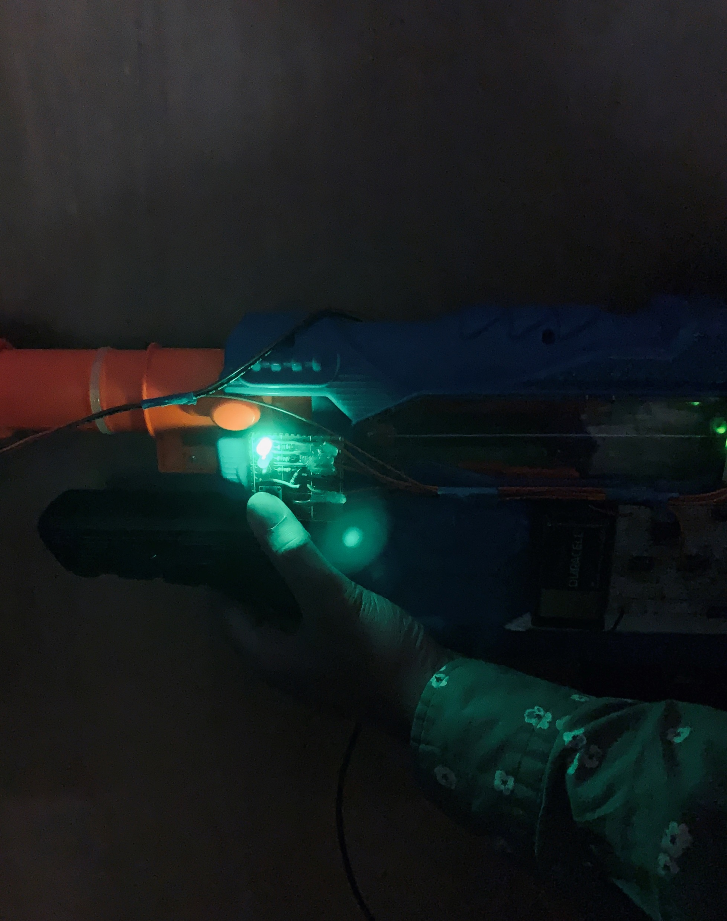
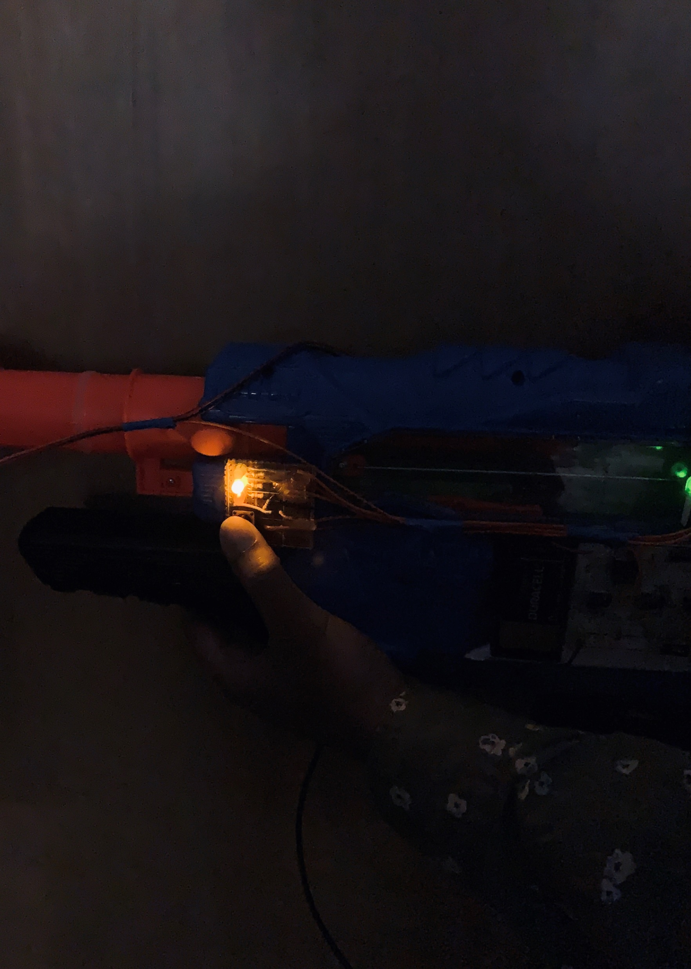
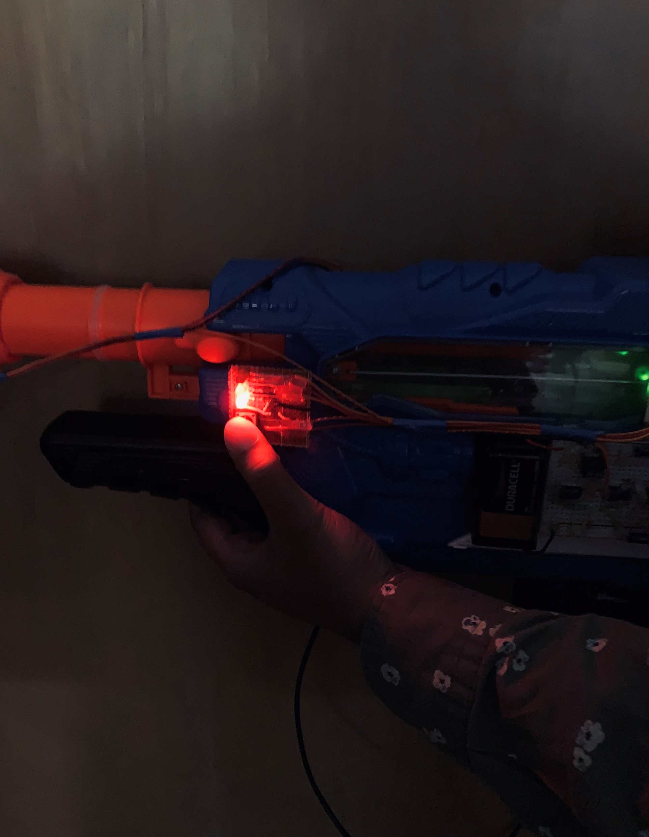
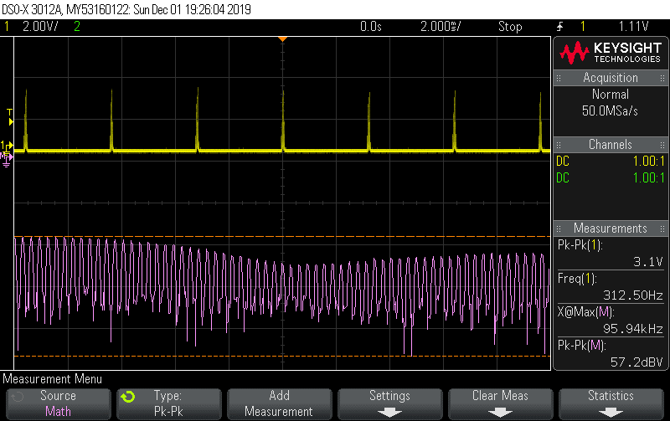
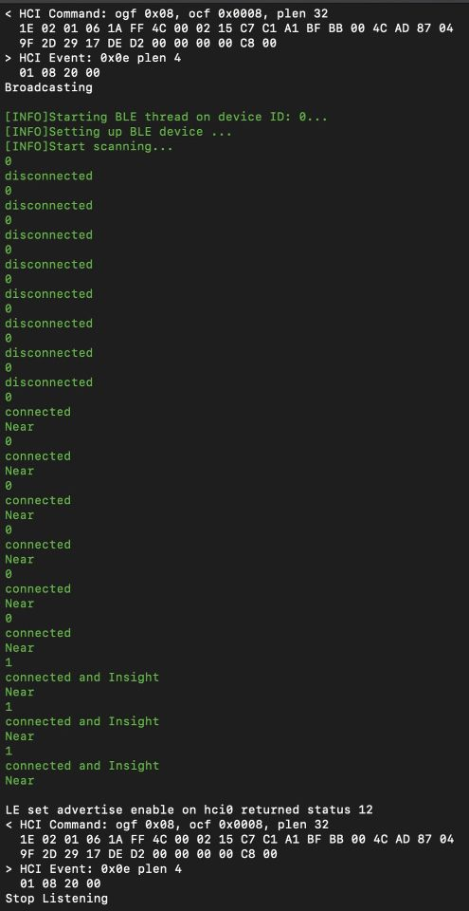
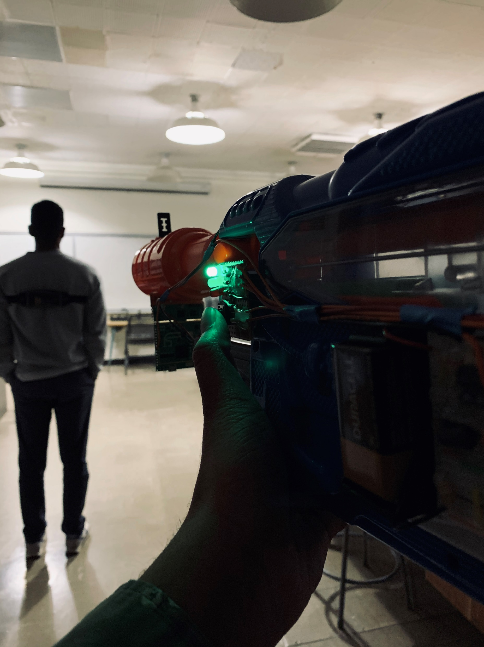
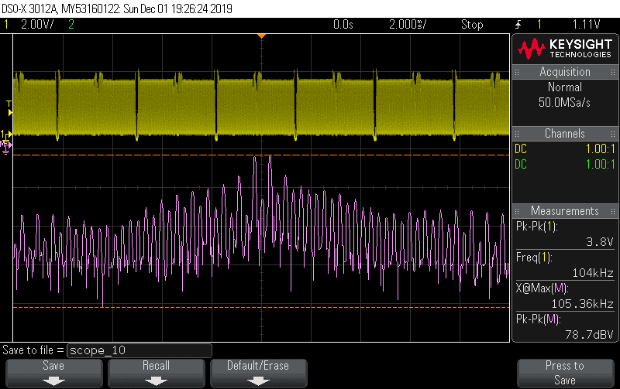
SixPlus: Infantry I.F.F. System
Vijay Krishnan, Vishal Devidas, Donghoon Han, Rishabh Patel, Kevin Waddles Advisor: Dr. Tentzeris
Background
Bluetooth Module
RF Module
Design Block Diagram
In the chaos of a battle, identification of forces can be a challenge, especially when warring sides share similar camouflage patterns and are usually hidden behind obstacles. The challenge of distinguishing a soldier as a “friend” or a “foe” can lead to an inadvertent attack by a military force on their own forces while attempting to pursue an enemy.
Incidents of friendly fire have plagued warring sides through the course of modern warfare. During the Gaza War of 2003, “three soldiers were killed and 24 others were injured” [2]. Moreover, during the Syrian Civil War in 2017, the United States military incorrectly identified a group of soldiers as adversaries, leading to an accidental attack resulting in 18 deaths [3]. Additionally, a recent analysis of empirical data from the Vietnam War and Operation Desert Storm report fratricide rates of 2% [1].
As a response to friendly fire incidents, IFF Systems were developed for military vehicles and fighter aircrafts for identifying aerial vehicles as a friend or a foe. Although the current IFF Systems prevent accidental firing among such vehicles, IFF systems protecting ground troops from friendly fire are underdeveloped. The production of an IFF system for ground troops is a necessity.
Components:
Bluetooth Unit
Functions as Bluetooth Beacon
Initiator Unit
Push button to stop active beacon and start beacon scanning
Release to resume system to active beacon
Indicator Unit
System of LED’s to display status
Blinks at different rates to indicate distance of the target for each status
Components:
FMCW Radar
Transmits 24 GHz signal
Backscatter Array
Reflects signal back to origin with phase shift
MF-IG BP Filter
Filters AC output to reduce noise and cross talk
ADC Unit
Converts Analog output to Digital to be fed into Bluetooth Module
System Design
Usage and Logistics
Highlights
Bluetooth Module
Usage
All soldiers will be broadcasting an encrypted Bluetooth beacon until Person A (interrogator) attempts to confirm the identity of person B.
Person A will point the firearm at Person B and push the initiator button which will convert his status from active beacon transmitter to listener and transmit a signal from his transceiver unit to Person B’s Backscatter Array.
Once Person A successfully decrypts the beacon from Person B, as well as confirms the line-of-sight status from the reflected RF signal, Person A can view the identification status of Person B on the indication unit on Person A’s firearm.
If Person A precisely aimed at the tag of Person B, a green LED will light up indicating Person B is in proximity and line-of-sight
If Person A did not aim his firearm directly at Person B, a yellow LED will light up indicating Person B is in proximity, however not in line-of-sight.
If Person B is out of range from Person A, a red LED will light up indicating that no targets are in proximity of Person A.
Battery powered as opposed to solar powered
Portable and lightweight
Independent: Functions as a standalone device
Secure:
2-factor confirmation makes enemy interception and tampering more difficult
Bluetooth beacon is encrypted
Versatile
IOT connected: The system software can be modified and metadata can be read remotely even via smartphone or tablet.
Programmable: The system specs can be recalibrated and changed as needed
What’s Been Tried?
FMCW Radar
Initiator & Indicator Units
MP-IG BP Filter
ADC Module
Researchers at Cornell University have developed an IFF System for Infantry that utilizes laser for signal propagation [4]. Some key drawbacks to this approach however, include:
Lasers require ideal weather conditions for expected functionality
Cannot penetrate through opaque surfaces
Incapable of directional reflection
Limited Security
Other similar products that have been specifically developed to identify ground troops employ a Centralized Beacon strategy. While this approach has a unique set of functional benefits, it too comes with its share of drawbacks which include:
Not independent
Non-scalable
Dome vs Direction
Figure 1. Labeled IFF System
Figure 2. In Range/Line of Fire
Figure 3. In Range/Not in Line of Fire
Figure 4. Not in Range
Logistics
The image to the left displays live results written to the Bluetooth Module’s console during the stages mentioned above:
‘disconnected’: no friendly targets in range (Red LED)
‘connected’: a friendly beacon was found by the scanner (Yellow LED)
‘connected and Insight’: a friendly beacon was found, and the initiators firearm is directed at the target (Green LED)
Our Proposal
Conclusion
Figure 6. Waveform with no targets in line of fire
The implementation of the system was a success. The SP-READ system operated as intended and can accurately state the status of a designated target instantly.
Limitations of the SixPlus team’s prototype of SP-READ include range and the ability to confirm a true negative.
Functional limitations of the product can be attributed to budget and technology restrictions, however the SixPlus team is confident that these challenges can be overcome with more sophisticated machinery and an increased budget.
To design and prototype a system that enables ground troops to more accurately identify friendly targets by combining the strengths from previous approaches and minimizing weaknesses.
RF signals: more robust than lasers, however difficult to encrypt
Bluetooth: greater operational radius, however difficult to direct
By utilizing both RF and Bluetooth however, we can compensate for the flaws of one system with the advantages of the other.
Figure 5. Demonstration (Explained in Usage section)
Figure 7. Waveform with targets in line of fire
Figure 8. System output read from console
Bluetooth Module Specifications
RF Module Specifications
Table 1. Bluetooth Beacon/Signal Authentication
Implemented Encryption | 8-byte variable encryption applied over two 4-byte sequences. All devices contain dynamic decryption libraries utilizing the same encryption algorithm applied to simultaneously changing seed values.
Suggested Encryption | American Encryption Standard (suggested)
Signal Type | Bluetooth Beacon with 16 byte UUID
Encryption Resolution | 8 bytes for authentication
Bluetooth Operational Voltage | 5V input regulated to 3.3V
Table 2. Backscatter Array
Operational Frequency | 24GHz
Power Consumption | 120mW
Functional Range | 50m to 100m
Reflection Precision | +/- 2 degrees
Battery Life | 2 hours
Table 3. Multi-Feedback Infinite Gain Bandpass Filter
Mid-Band Gain (AV) | 16.000
Critical Frequency | 106.355 kHz
Quality Factor | 9.351
Table 4. Transceiver Unit (FMCW)
Frequency Range | 24.025 GHz – 24.225 GHz
Chirps | Chirp Time: 3000 us, Samples per Chirp: 32, Chirps per Frame: 42, Shape: upchirp
Bandwidth | 200 MHz
Antennas | RX: 2, TX: 1
Device Settings | RX BGT LNA Gain: Enabled
References
[1] Mark Thompson, “The Curse of ‘Friendly Fire’”, Time Magazine, Jun. 11, 2014. [Online]. Available: http://time.com/2854306/the-curse-of-friendly-fire/. [Accessed Mar. 4, 2019]
[2] H. Greenberg, “Gaza: 3 soldiers killed, 24 injured in friendly fire incident,” Ynetnews, 14-Jun-2011. [Online]. Available: https://www.ynetnews.com/articles/0,7340,L-3651165,00.html [Accessed: 19-Apr-2019].
[3] F. News, “'Misdirected' airstrike killed 18 allied Syrian forces, US military confirms,” Fox News, 13-Apr-2017. [Online]. Available: https://www.foxnews.com/world/misdirected-airstrike-killed-18-allied-syrian-forces-us-military-confirms. [Accessed: 19-Apr-2019].
[4] W. H. Lui and A. Shreedhar, “IFF System for Infantry,” IFF System for Infantry - Cornell ECE 4760. [Online]. Available: http://people.ece.cornell.edu/land/courses/ece4760/FinalProjects/f2012/wl378_as889/index.html. [Accessed: 19-Apr-2019].

